Slide 1

1st National Conference on Sustainable Civil Engineering & Geospatial Technologies: Materials & Innovations for Climate Resilience (NCRT-SCE 2026) Buddha Institute of Technology GIDA, Gorakhpur Date of Conference: 15th – 16th April 2026
“SHELL FIBRE : INNOVATIVE CONCRETE COMPOSITES ”
Under the Guidance
Mr. Rahul Kumar Shukla
Assistant Professor
Presented By:
Saurav Dubey
2305250009019
4th Year
Department of Civil Engineering, BIT Gorakhpur

Slide 2
Contents
Introduction
Problem Statement
Objectives
Literature Survey
Proposed Solution / Methodology
Results & Analysis
Conclusion & Future Work
Acknowledgements
References

Slide 3
Introduction
Conventional concrete, a major change in modern construction, faces growing survey due to its substantial environmental impact, primarily from the extraction of natural aggregates and the energy-intensive production of cement.
This has encouraged a global shift towards sustainable construction practices that highlight the utilization of recycled materials and industrial or agricultural waste byproducts.
The incorporation of waste materials not only addresses disposal challenges but also has the potential to enhance specific properties of the concrete while reducing overall costs.

Slide 4
Problem Statement
The primary problem statement is articulated by the following challenges and research gaps:
Environmental Degradation and Resource Depletion: The conventional concrete industry heavily relies on natural coarse aggregates (gravel and granite), leading to rapid depletion of natural resources, environmental damage from quarrying, and ecological imbalance.
Performance Limitations of Standard Green Concrete: While using coconut shells as a coarse aggregate replacement creates lightweight concrete (LWC), it also generally results in a reduction in compressive, tensile, and flexural strengths compared to standard concrete, especially at higher replacement percentages.
Material Property Variability and Durability Concerns: Coconut shells have a significantly higher water absorption rate and greater material property variability than conventional aggregates, which can affect the concrete's workability, strength, and long-term durability (e.g., resistance to cracking and chemical attack).

Slide 5
Objectives
Objective 1: Composites Waste Valorization: To repurpose industrial and agricultural waste (seashells, coconut shells) into high-value construction materials, reducing landfill pressure.
Objective 2: Carbon Footprint Reduction: Tolower the environmental impact by replacing carbon-intensive natural aggregates with eco-friendly bio-fillers.
Objective 3:Enhanced Tensile Strength: To utilize the fibrous and plate-like structure of shells to improve the concrete's ability to resist pulling forces and bending.
Objective 4: Structural Weight Optimization: To produce lightweight concrete that reduces the overall dead load of a structure, leading to smaller foundation requirements.

Slide 6
Literature Survey
A literature survey on concrete incorporating coconut shells (CS) as a partial replacement for coarse aggregate and glass fibers (GF) as reinforcement.
It reveals significant potential for creating sustainable and lightweight construction materials with enhanced mechanical properties.
Research indicates that these materials offer a viable solution for managing agricultural waste and reducing reliance on natural aggregates.

Slide 7
Proposed Solution / Methodology
The methodology for creating concrete with coconut shell and glass fibre involves material preparation, mix design using a standard code of practice, mixing, casting, curing, and testing. The coconut shells act as a lightweight coarse aggregate replacement, and the glass fibres enhance the concrete's tensile and flexural properties.
Material Preparation
Coconut Shells (CS): Acquire waste coconut shells, clean them to remove impurities, and air-dry them. Crush the shells to a specific size range, typically 4.75 mm to 12.5 mm or 12.5 mm to 20 mm, to be used as a partial replacement for conventional coarse aggregate. Due to high water absorption, the CS aggregates should be used in a Saturated Surface Dry (SSD) condition, often achieved by oven-drying to a constant weight and then accounting for absorption, or pre-soaking.
Glass Fibers (GF): Use commercially available Alkali-Resistant (AR) glass fibers, typically with a length of 13 mm to 18 mm and varying aspect ratios. The fibers should be dispersed uniformly to avoid balling effects during mixing

Slide 8
Results & Analysis
Compressive Strength
The compressive strength of concrete blocks made with a combination of glass fiber and coconut shell aggregate is highly variable, typically falling within the range of 10 N/mm² to 28 N/mm² at 28 days of curing, depending heavily on the specific mix proportions and percentages used.
Mix Design
Determine Proportions: The mix proportions are designed to achieve a target compressive strength (e.g., M20, M30 grade) as per relevant standards like IS 10262, ASTM, or EN codes.
Replacement Levels: The coconut shells typically replace a percentage of the coarse aggregate (e.g., 15%, 30%, 45%, or up to 60%) by weight or volume.
Fiber Content: Glass fibers are typically added as a percentage of the total volume or weight of cement (e.g., 0.5%, 1.0%, 1.5%, or 2.0%).
Optimize Additives: A superplasticizer is crucial to improve the workability of the mix, which generally decreases with the addition of fibres and coconut shells.

Slide 9
Grade of concrete used for the experiment :- M20 (1:1.5:3)
Mixing and Casting
Dry Mixing: Initially, the dry materials—cement, fine aggregate, coarse aggregate, and coconut shell aggregate—are mixed thoroughly in a drum or pan mixer to ensure uniformity.
Wet Mixing and Fibre Addition: A pre-determined amount of water (with the superplasticizer dissolved in it) is added to the dry mix. The fibres (both glass and, if used, coconut fibres) are added during the wet mixing process to ensure even dispersion and prevent clumping.
Workability Test: Perform a slump test on the fresh concrete to check workability and ensure it is within the desired range.

Slide 10
Casting Specimens: The fresh concrete is poured into standard moulds (e.g., 150 mm cubes for compressive strength, 150 mm diameter x 300 mm cylinders for split tensile strength, and beams for flexural strength) in layers. Each layer is compacted using a tamping rod and/or a concrete vibrator to remove air voids.
Initial Curing: The specimens are kept undisturbed for 24 hours at room temperature and covered with a plastic sheet or wet burlap to prevent moisture loss.
Demoulding and Curing: After 24 hours, the specimens are demolded and immediately submerged in clean fresh water in a curing tank, maintained at a specific temperature (e.g., 27 ± 2°C) until the designated testing age.
Mechanical Testing:
Compressive Strength: Test the cubes at specified ages (e.g., 7, 14, and 28 days) using a compression testing machine as per standards like IS 516.
Split Tensile Strength: Test the cylinders at the specified ages (e.g., 28 days) using a universal testing machine according to standards like IS 5816.
Flexural Strength: Test the beam specimens at the specified ages using a flexural testing machine, often with a three- or four-point loading method as per standards like ASTM C78.

Slide 11
Material Preparation
Coconut Shells (CS): Acquire waste coconut shells, clean them to remove impurities, and air-dry them. Crush the shells to a specific size range, typically 4.75 mm to 12.5 mm or 12.5 mm to 20 mm, to be used as a partial replacement for conventional coarse aggregate. Due to high water absorption, the CS aggregates should be used in a Saturated Surface Dry (SSD) condition, often achieved by oven-drying to a constant weight and then accounting for absorption, or pre-soaking.
Glass Fibers (GF): Use commercially available Alkali-Resistant (AR) glass fibres, typically with a length of 13 mm to 18 mm and varying aspect ratios. The fibres should be dispersed uniformly to avoid balling effects during mixing.
Other Materials: Use ordinary Portland cement (OPC) (e.g., 53 grade), fine aggregate (river sand or M-sand), coarse aggregate (crushed stone), water, and a high-range water-reducing admixture (superplasticizer) to maintain workability.

Slide 12
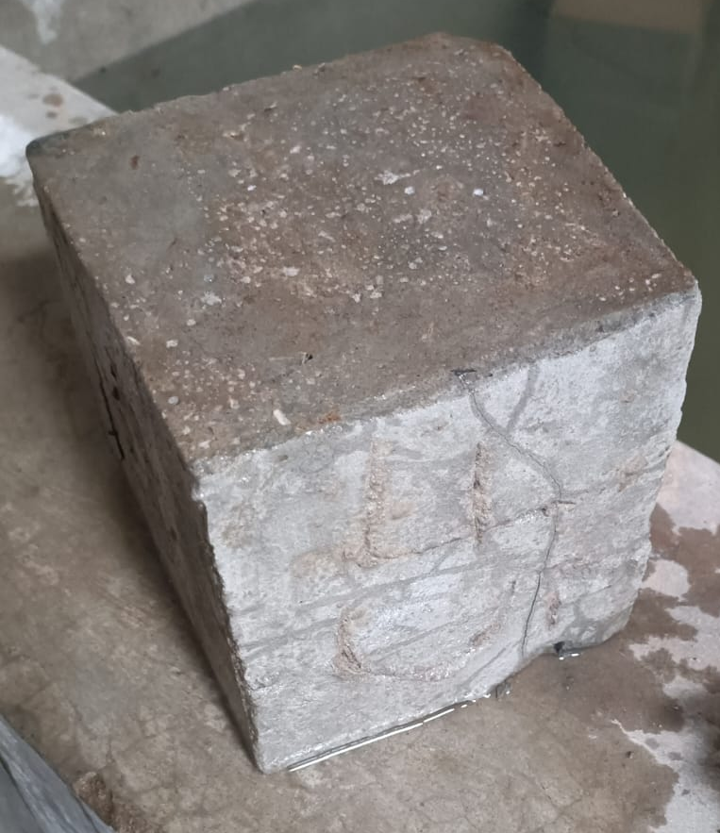
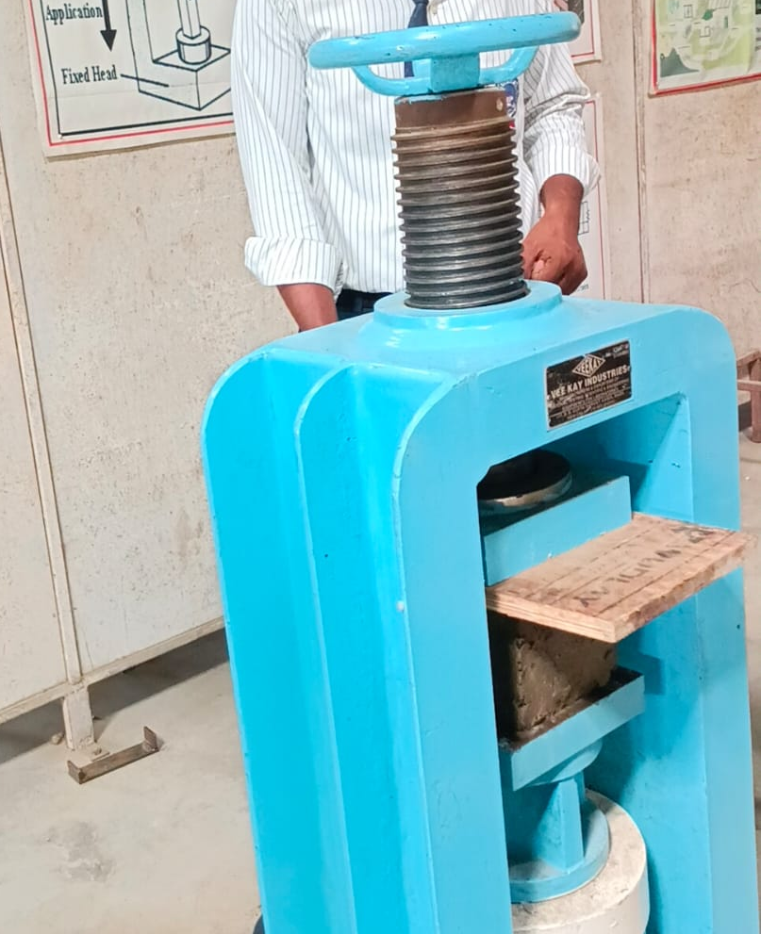
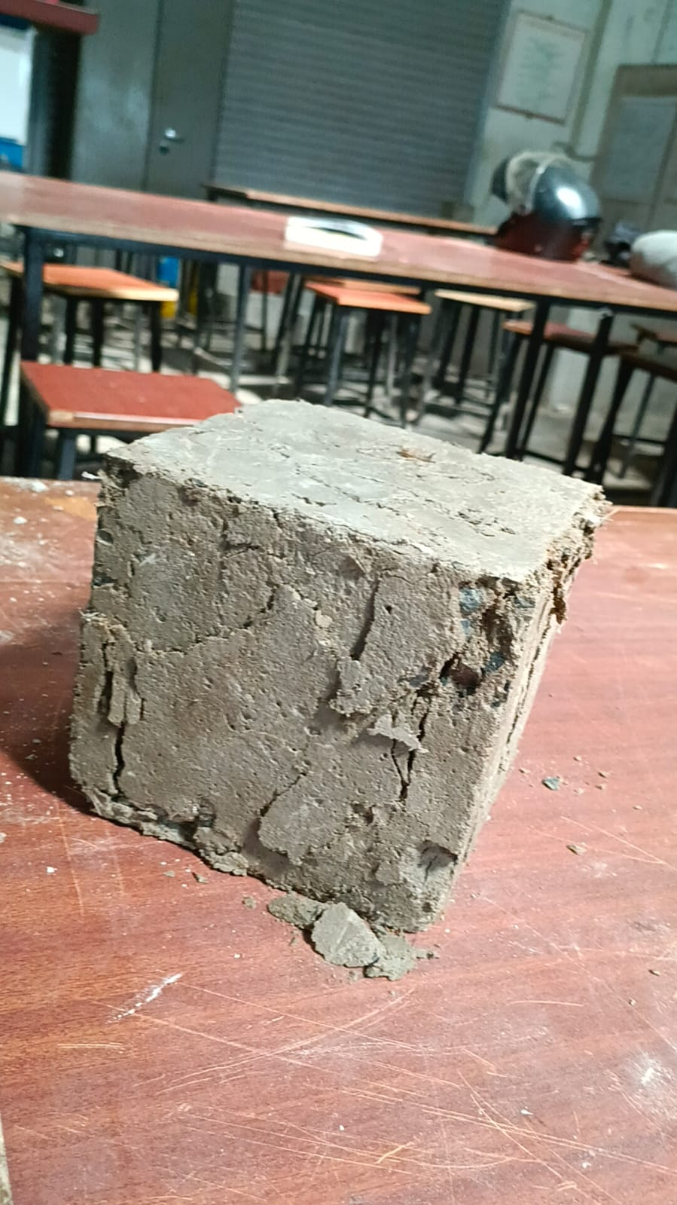
Compressive Strength :-
No. of Days | Compressive Strength
7Days | 14.67 N/mm²
14Days | 16.43 N/mm²
28 Days | 19.79 N/mm²
Curing
Compressive Strength Test
Specimen after Loading

Slide 13
Conclusion & Future Work
In conclusion, literature supports the feasibility of "coconut shell and glass fiber concrete" as an eco-friendly and economically viable alternative to conventional concrete, provided appropriate mix designs and material treatments are utilized to manage properties like water absorption and ensure optimal strength development.

Slide 14
Acknowledgements
Guide:
I would like to express my sincere and heartfelt gratitude to my respected guide Mr. Rahul Shukla, Assistant Professor Department of Civil Engineering, for his constant guidance, valuable suggestions, motivation, and continuous support throughout the completion of this research work. His technical expertise and encouragement helped me in successfully completing this study.
Institution:
I would also like to express my sincere thanks to Buddha Institute of Technology, Gorakhpur for providing a supportive academic environment, necessary resources, and infrastructure facilities which made this research work possible. I am also thankful to the Department of Civil Engineering for their cooperation and support.

Slide 15
References
Citations (for a formal paper/report)
[1] John, V. M., and D. S. L. T. Santos. "Waste materials in concrete: A review." Journal of Cleaner Production, 2020. (Example citation, actual sources would be used).
[2] Smith, A. B. "Properties of Glass Fibre Reinforced Concrete." Cement and Concrete Research, 2018. (Example citation, actual sources would be used).

Slide 16
Thank You

